Slide 1
IS4432 Systems Design
Week 10: Physical Architecture Layer Design
Adapted by Janet Yu
115/11/07

Slide 2
Agenda
Different physical architecture components
Three principal architectures:
  Server-based
  Client-based
  Client-server
Non-functional requirements in physical architecture design
Various considerations for hardware & software specification
Deployment Diagram
115/11/07

Slide 3
What is physical architecture layer design?
The plan for how the system will be distributed across the computers and what hardware and software will be used
The goal is to determine what parts of the application software will be assigned to what hardware.
115/11/07

Slide 4
Physical Architecture
Software Components
  Data Storage
  Data Access Logic
  Application logic
  Presentation logic
Hardware Components
  Client computers
  Servers
  Connecting network
115/11/07

Slide 5
Three Principal Architectures
Server-Based architecture
Client-Based architecture
Client-Server architecture
115/11/07

Slide 6
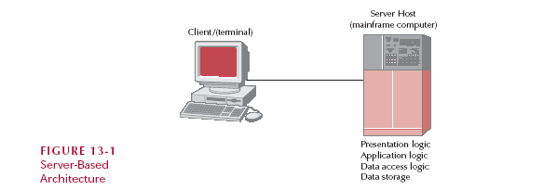
1. Server-Based Architecture
only accept keystrokes and sent them to the server for processing and accepted instructions from the server on what to display
115/11/07

Slide 7
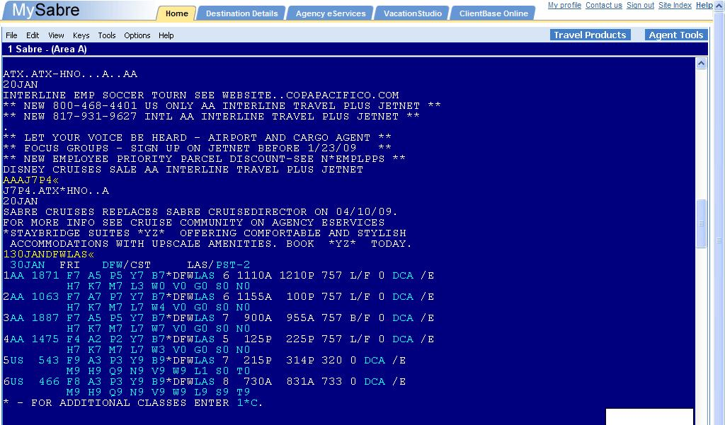
Example: SABRE, a server-based application, for airline reservation
Source: http://www.sabretravelnetwork.com/
115/11/07

Slide 8
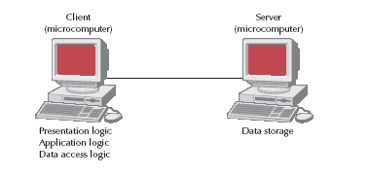
2. Client-Based Architecture
115/11/07

Slide 9
3. Client-Server Architecture
Most common!
Balance the processing between the client and the server
  Client is responsible for the presentation logic
  Server is responsible for the data access logic and data storage
  The application logic may be on either the client or the server or be split between both.
115/11/07

Slide 10
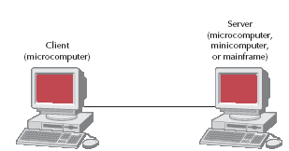
Client-Server Architecture
Presentation logic Application logic
Data Access logic
Data Storage
Presentation logic Data Access logic
Application logic Data Storage
115/11/07

Slide 11
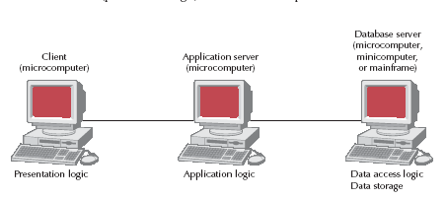
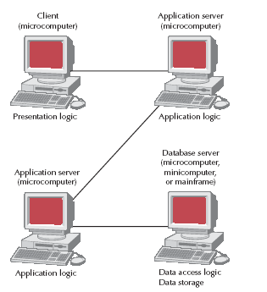
Client-Server Architecture
3-tiered Architecture
Slide <number>
N-tiered Architecture
115/11/07

Slide 12
Advantages and Limitations
Advantages
  Scalable
    Easy to increase or decrease the capabilities of the servers – by adding servers.
  Failover
    When one server is down, other servers can still function
Limitations
  Developing application software for client-server architecture is more complicated and thus costly
  Update application logic in client requires update on all clients.
115/11/07

Slide 13
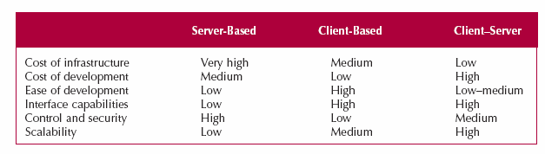
Comparing Various Architectures
115/11/07

Slide 14
How to Choose?
Slide <number>
Usually follow existing architecture
Also need to consider corporate standards
In addition, nonfunctional requirements has a strong impact on physical architecture layer design
115/11/07

Slide 15
Nonfunctional Requirement Types
Operational
Performance
Security
Cultural and Political
115/11/07

Slide 16
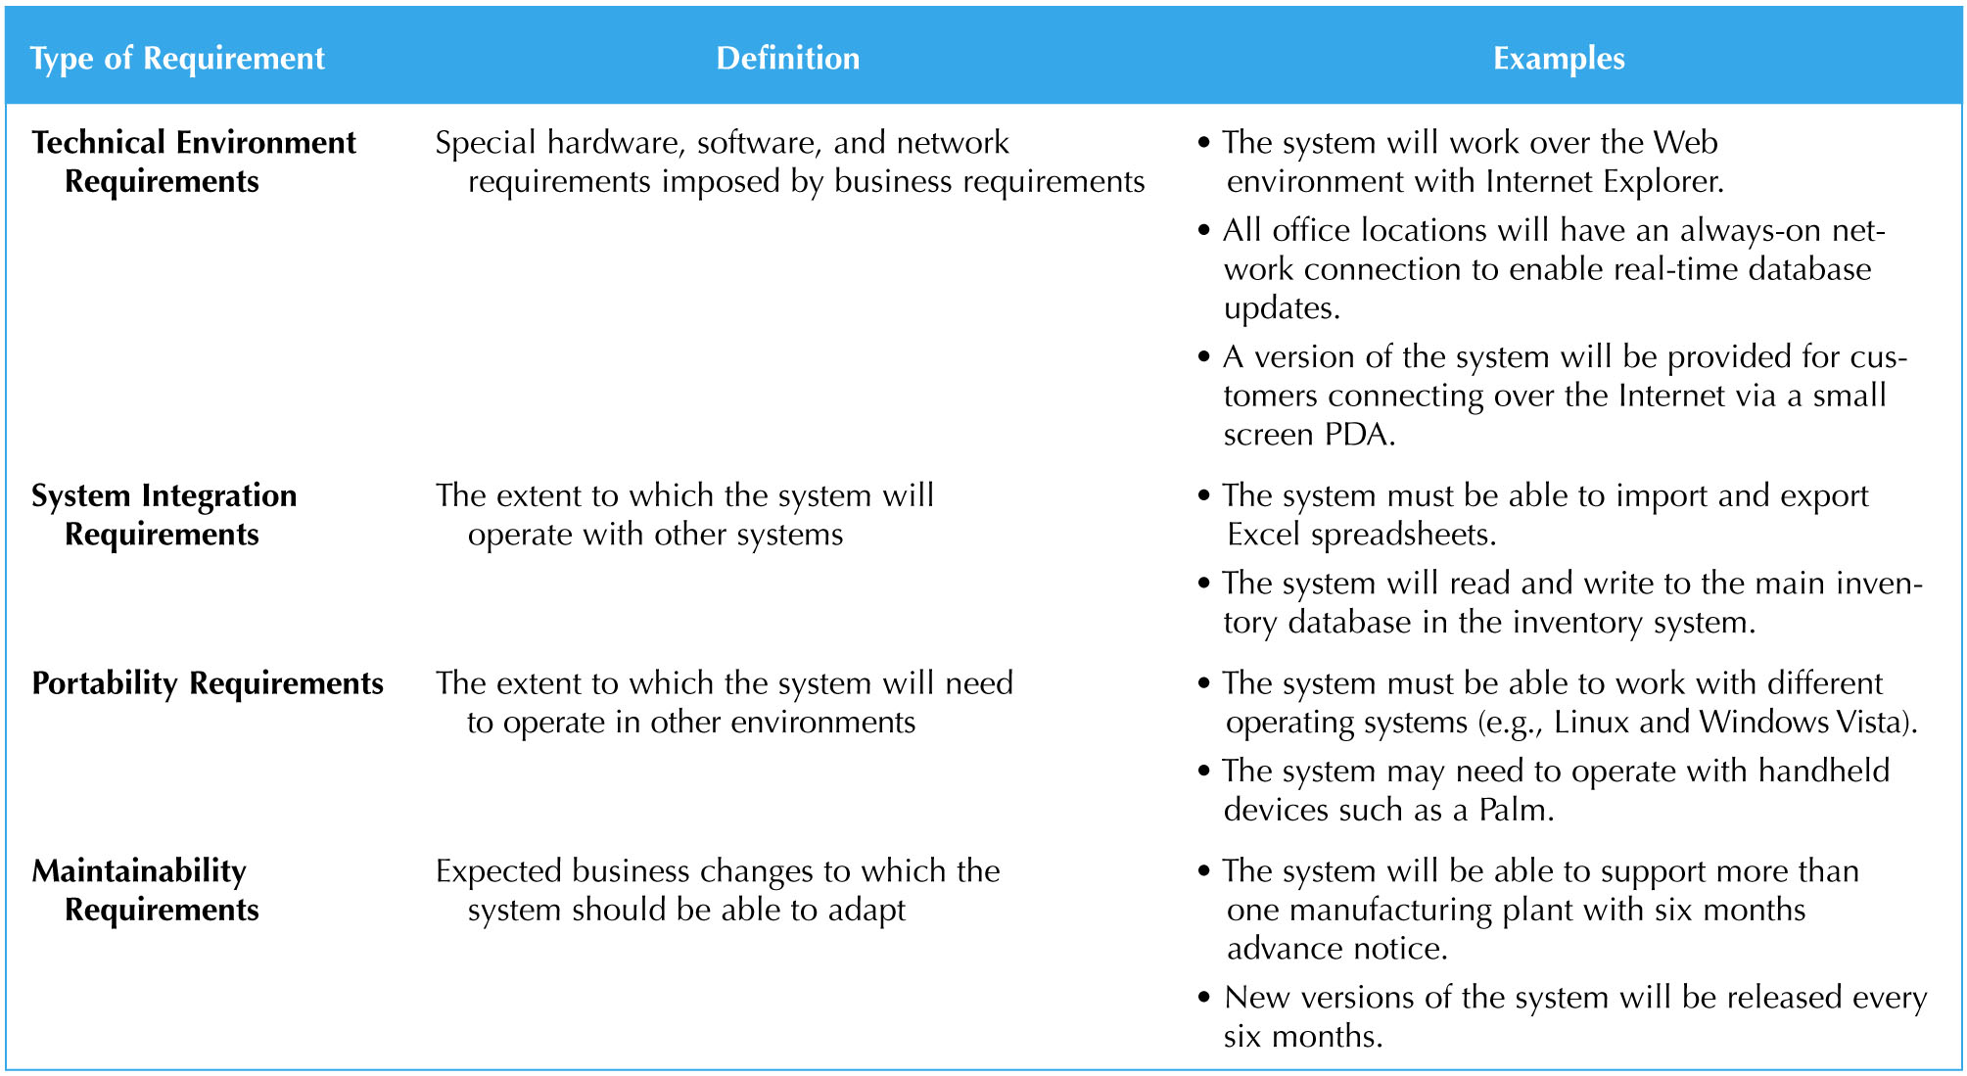
Operational Requirements
115/11/07

Slide 17
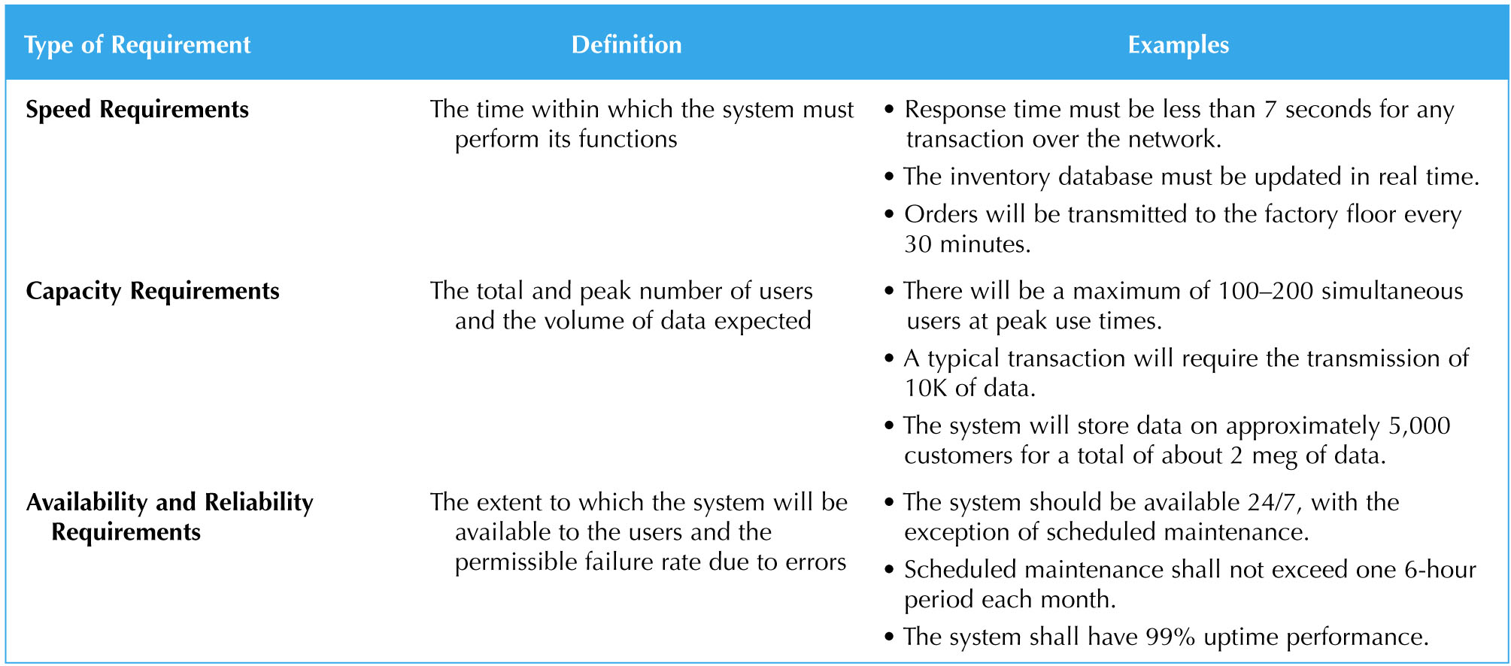
Performance Requirements
115/11/07

Slide 18
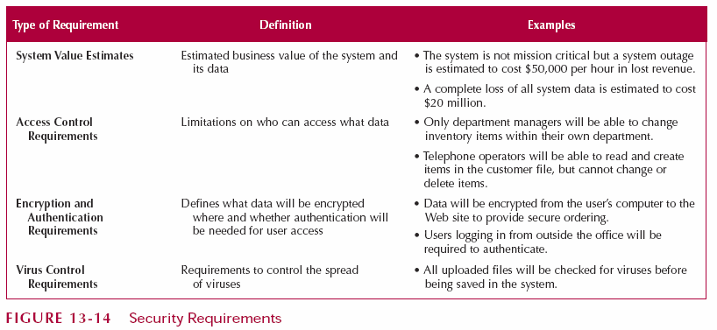
Security Requirements
115/11/07

Slide 19
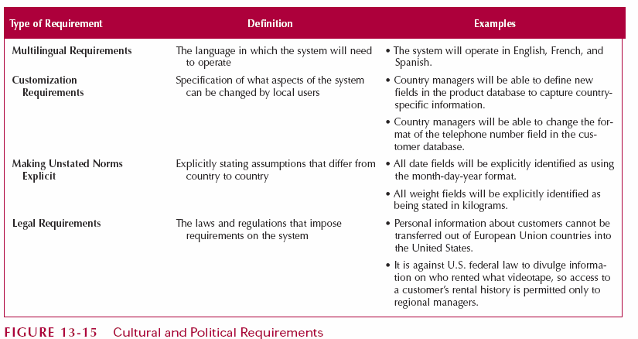
Cultural and Political Requirements
115/11/07

Slide 20
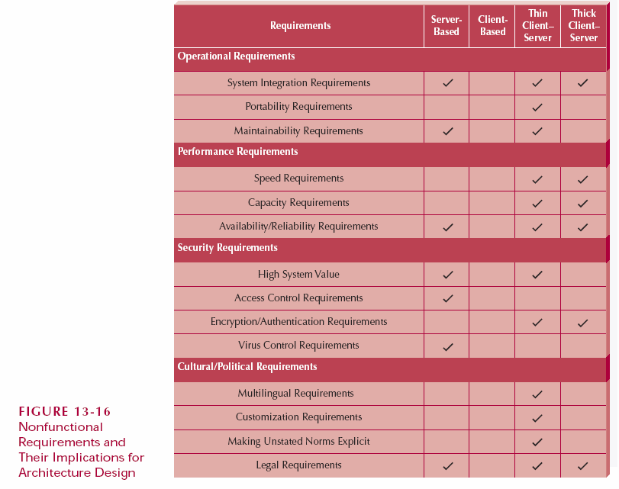
Implications of Nonfunctional Requirements for Architecture Design
115/11/07

Slide 21
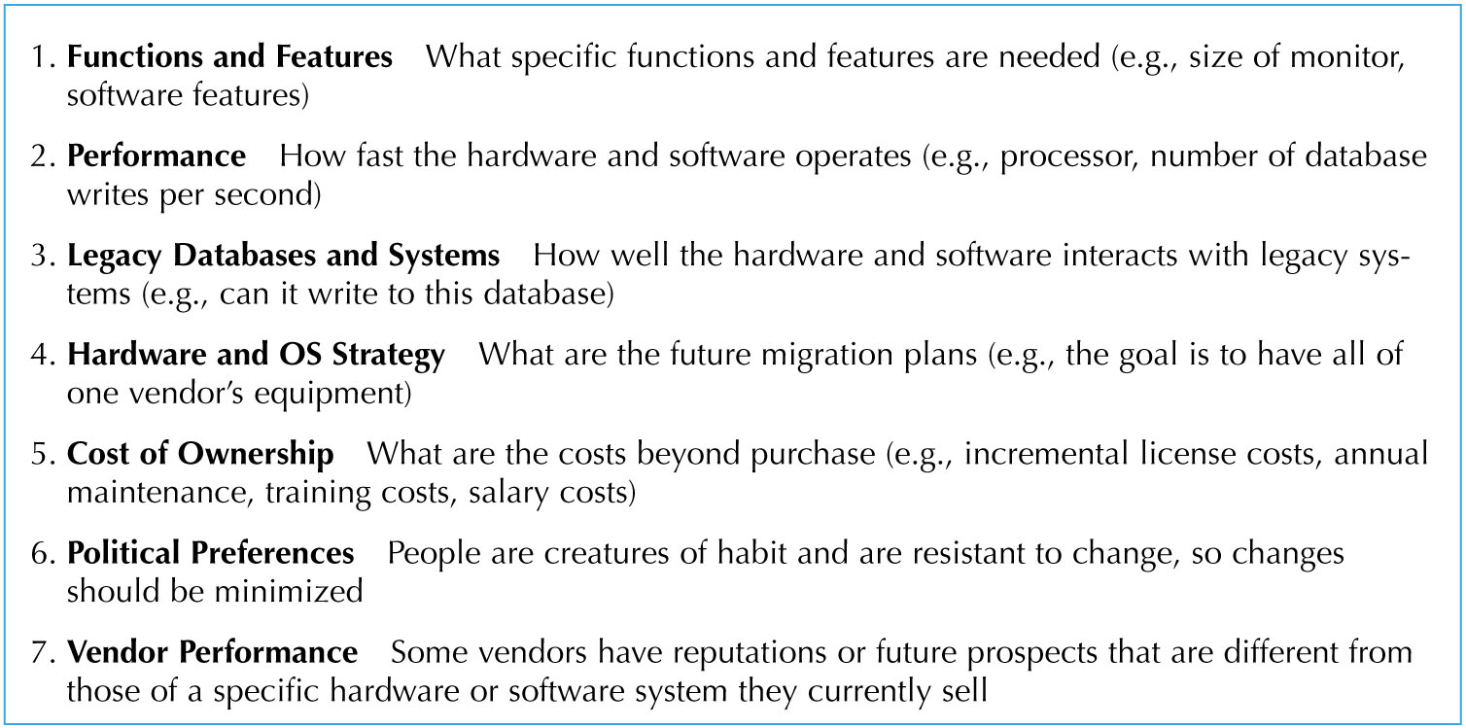
Hardware & Software Specification
Usually use existing hardware and software or follow corporate standards. Other considerations include:
115/11/07

Slide 22
Deployment Diagram
Represent relationships between hardware components of an information system
Elements of a deployment diagram
  Nodes: a computational resource
  Artifacts: a piece of the information system which will be installed on a node
  Communication paths: a communication link such as a network connection or a USB cable
115/11/07

Slide 23
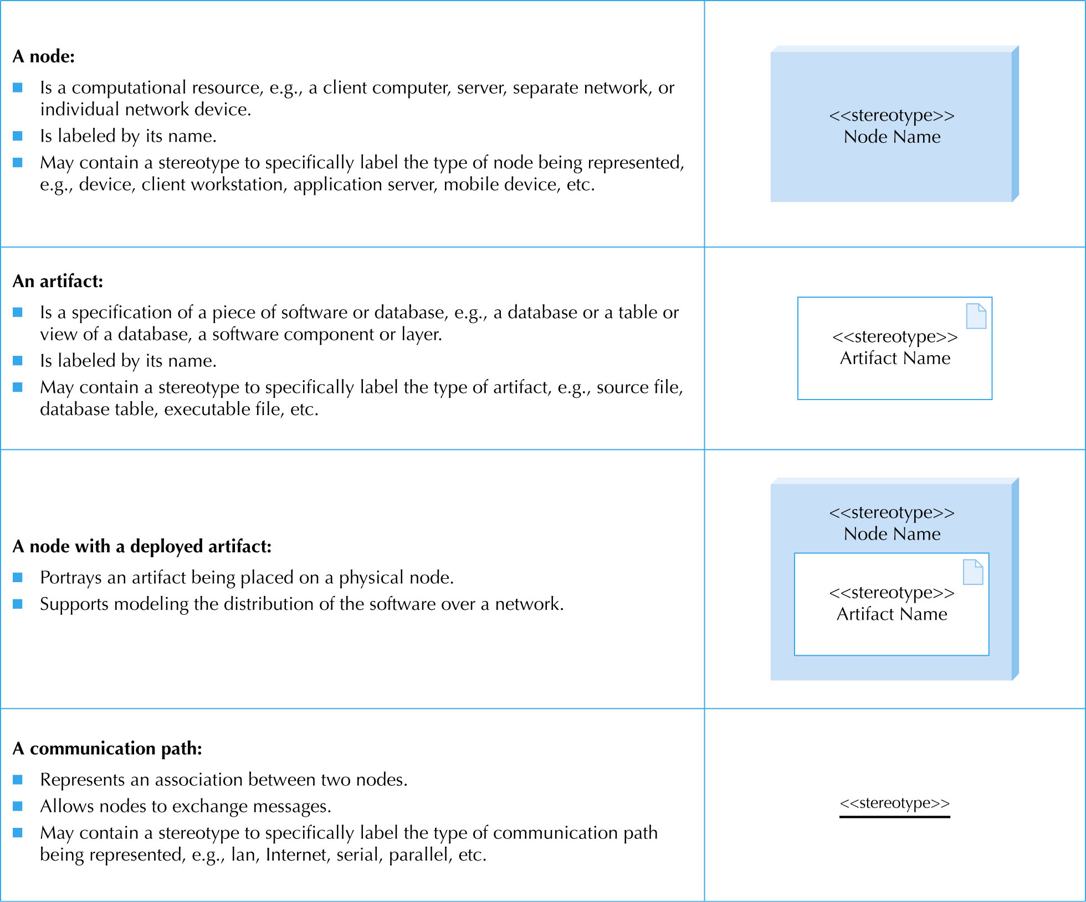
115/11/07

Slide 24
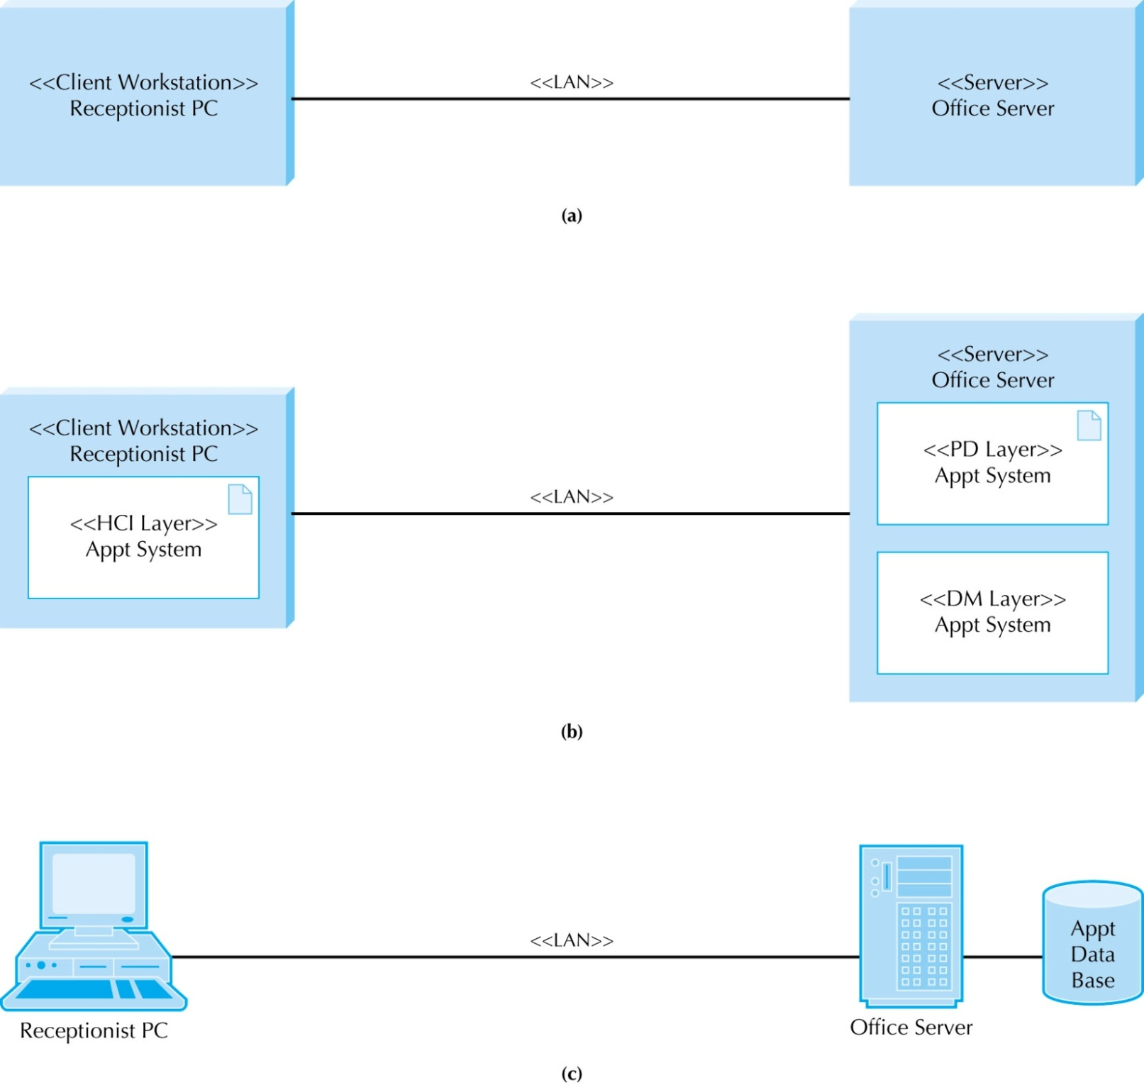
Three Versions of a Deployment Diagram
115/11/07

Slide 25
Network Model
Shows the major components of the information system (e.g. servers, communication lines, networks) and their geographic locations throughout the organization
Purposes of the network model:
  To convey the complexity of the system
  To show how the system’s software components will fit together
115/11/07

Slide 26
How to Draw a Network Model
No one single way
Can create your own standards and symbols
Can use Visio or UML’s Deployment Diagram
Locations are the geographic sites
Connect them with lines that are labeled with the approximate amount of data or types of network circuits
115/11/07

Slide 27
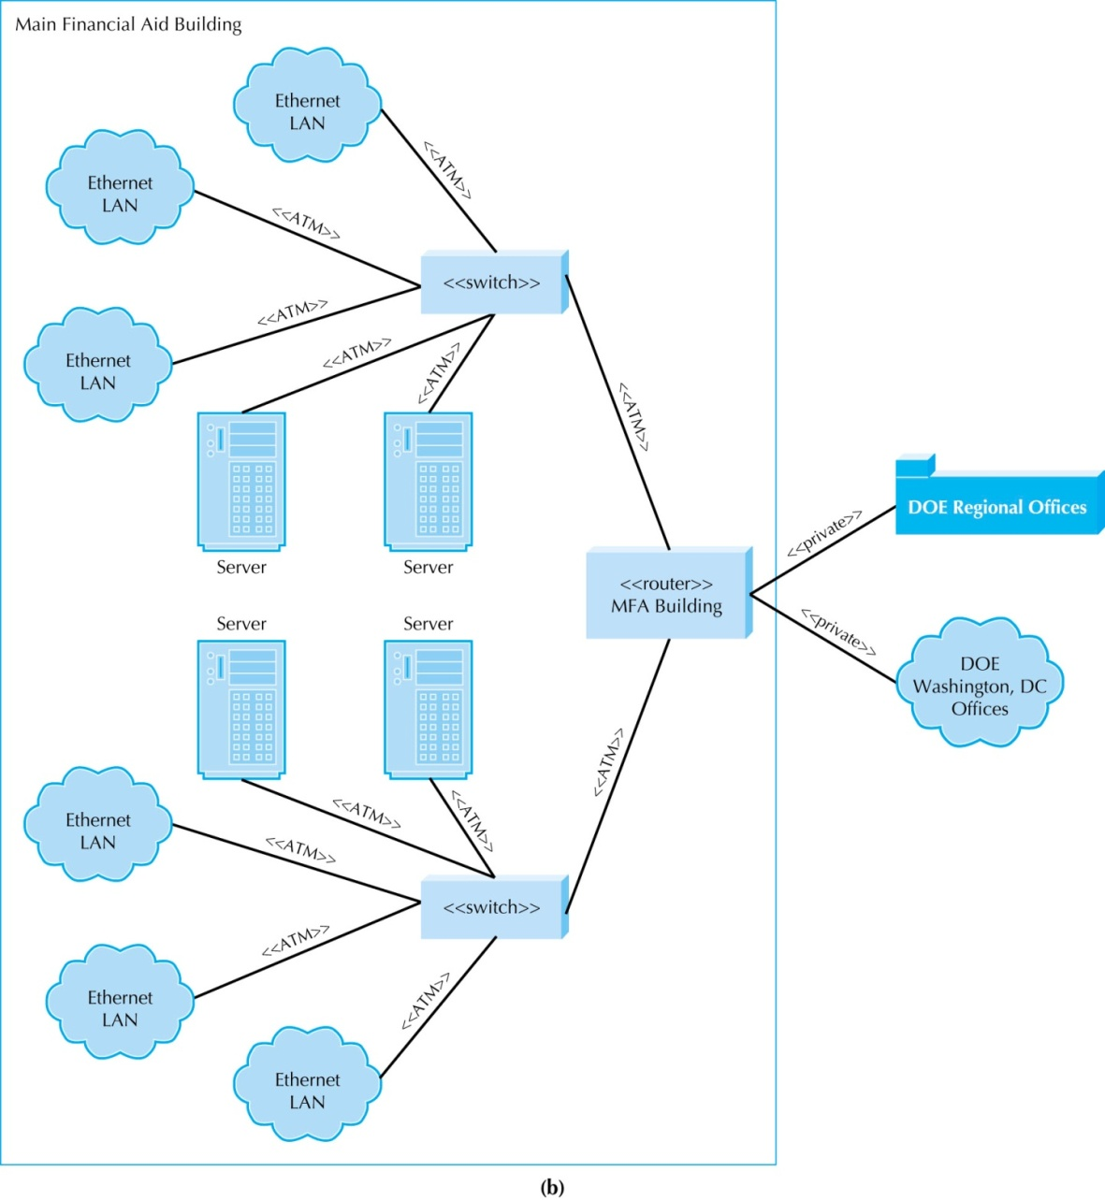
Sample Low-level Network Model
115/11/07

